Slide 1
WHO WOULD YOU
LIKE TO BECOME?

Slide 2
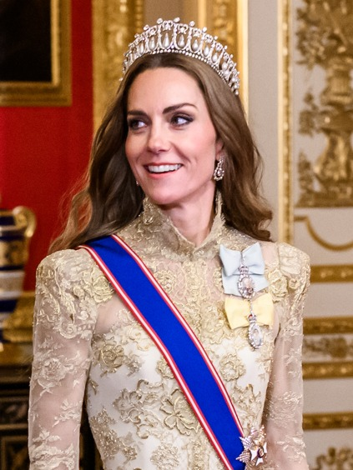
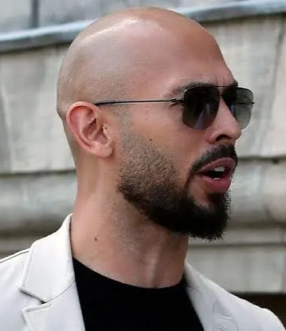
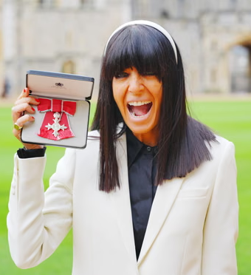
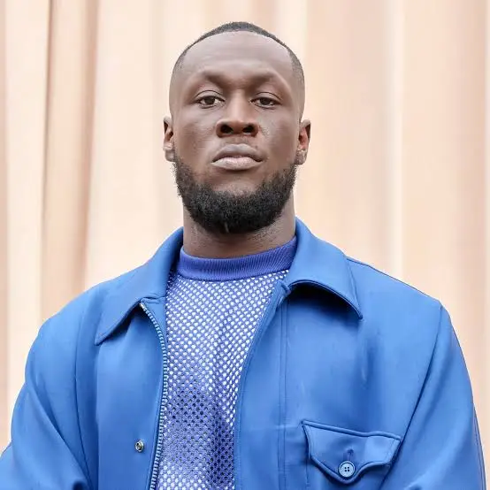
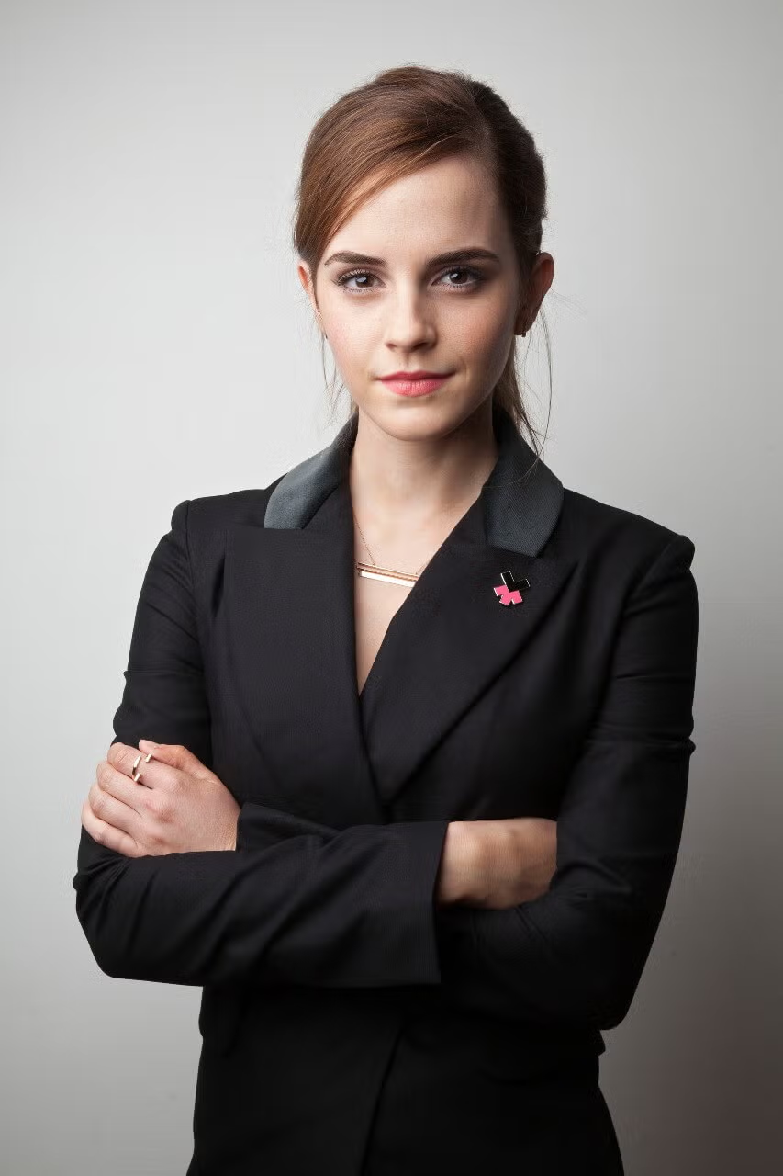
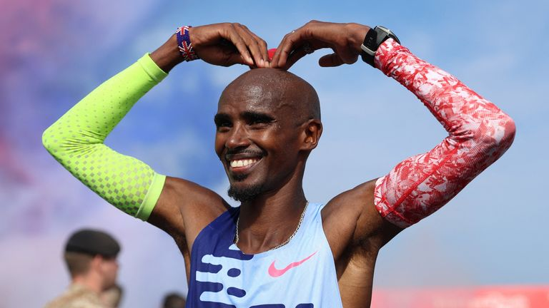
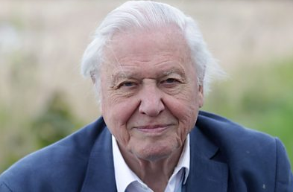
Notes:
“what it looks like to honor God with your body in everyday rhythms.”
Gnosticism

Slide 3
FREEDOM &
DISCIPLINE
Notes:
“what it looks like to honor God with your body in everyday rhythms.”
Gnosticism

Slide 4
FREEDOM
19 Though I am free and belong to no one, I have made myself a slave to everyone, to win as many as possible. 20 To the Jews I became like a Jew, to win the Jews. To those under the law I became like one under the law (though I myself am not under the law), so as to win those under the law. 21 To those not having the law I became like one not having the law (though I am not free from God’s law but am under Christ’s law), so as to win those not having the law.
To the weak I became weak, to win the weak. I have become all things to all people so that by all possible means I might save some. 23 I do all this for the sake of the gospel, that I may share in its blessings.
1 Corinthians 9:19-23

Slide 5


PARADOX
OF FREEDOM

Slide 6
FREE FROM…
WORRY
STATUS
CONTROL
PAST
ADDICTIONS
RELATIONSHIPS
PRIDE
MONEY

Slide 7
WORRY
ADDICTIONS
PRIDE
STATUS
PAST
MONEY
CONTROL

Slide 8
WHO IS GOD CALLING
YOU TO BECOME?
Notes:
“what it looks like to honor God with your body in everyday rhythms.”
Gnosticism

Slide 9
DISCIPLINE
24 Do you not know that in a race all the runners run, but only one gets the prize? Run in such a way as to get the prize. 25 Everyone who competes in the games goes into strict training. They do it to get a crown that will not last; but we do it to get a crown that will last for ever. 26 Therefore I do not run like someone running aimlessly; I do not fight like a boxer beating the air. 27 No, I strike a blow to my body and make it my slave so that after I have preached to others, I myself will not be disqualified for the prize.
1 Corinthians 9:24-27

Slide 10
TRAINING
Notes:
Gifts of the Spirit
Truth – train our minds
Surrender
Faith – Trusting God
Worship – why can’t we just have one song after the talk. Songs are prayers, we’re giving God his rightful place, we’re being filled by the Holy Spirit
Prayer

Slide 11
To the weak I became weak, to win the weak. I have become all things to all people so that by all possible means I might save some. I do all this for the sake of the gospel, that I may share in its blessings.

Slide 12
…but we do it to get a crown that will last for ever. Therefore, I do not run like someone running aimlessly; I do not fight like a boxer beating the air. No, I strike a blow to my body and make it my slave so that after I have preached to others…
INTENTIONALITY
Notes:
Intentionality about Paul that is fascinating
What do you need to train on? How can you train yourself?
Maybe it’s just being intentional: praying on your way to work, who do you want to speak to today?
Maybe it’s recognizing thoughts that aren’t from God and speaking truth to them
Maybe it’s letting go of worry?
Maybe it’s being free from people pleasing?
God wants us to be confident in who we are in him, so we don’t need to show off, don’t need to please, don’t need to anything, just depend on him, trust him, be filled by the Holy Spirit, depend on his voice and power, do be a Greek to the Greek, jew to the jew, build his Kingdom.

